Slide 1

Dynamic Traffic
Management

Slide 2
Problems with the current system
Most work on simple timers
Not very flexible
Leads to long queues during peaks
Unnecessary stopping when roads are free

Slide 3
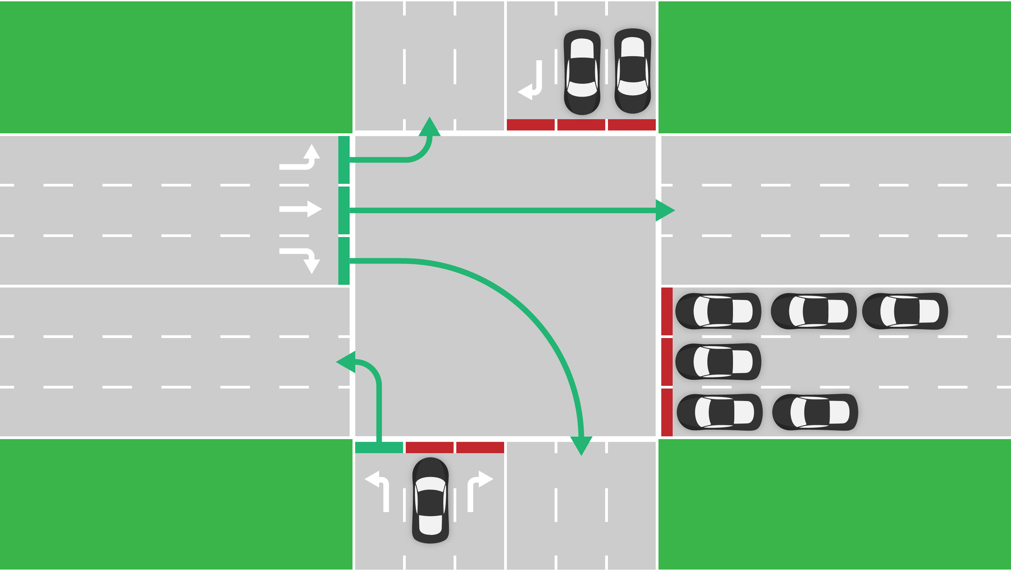
Problems with the current system
Notes:
Unnecessary waiting

Slide 4


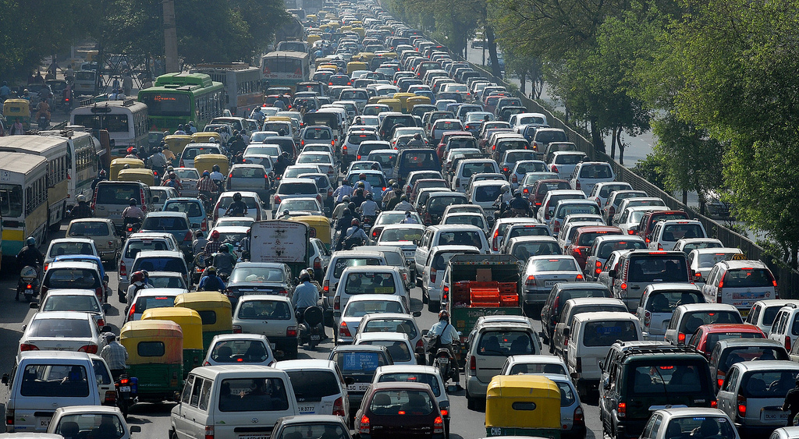
Dynamic system
Notes:
Network of communicating traffic lights
Cameras – Computer Vision
Use this to regulate traffic flow

Slide 5
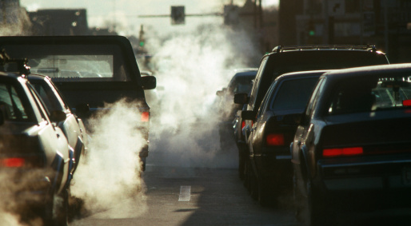

Why is this important?

Slide 6
Our approach

Slide 7
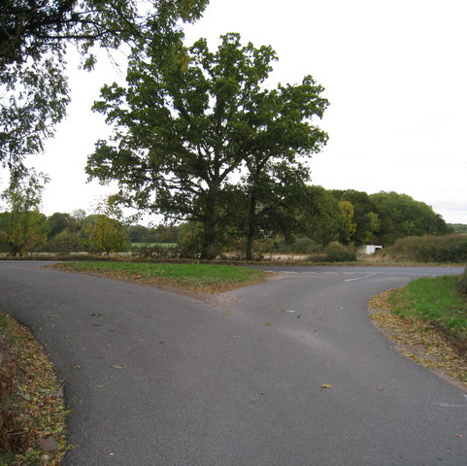
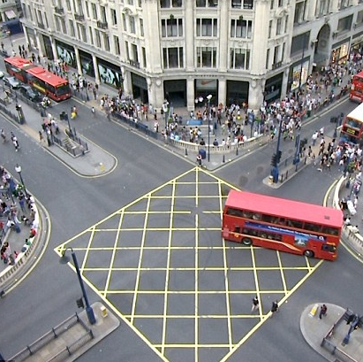
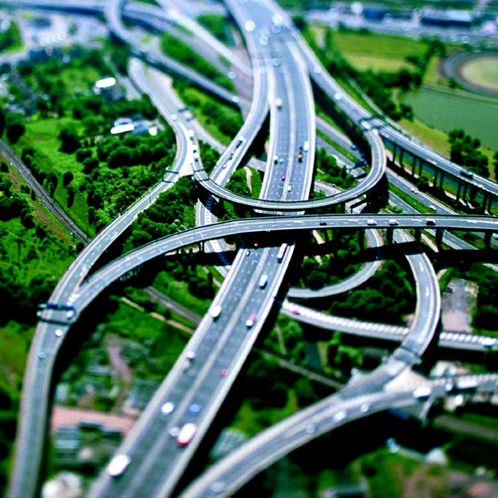
Modeling a junction
Notes:
The first challenge when modeling traffic is that there is a huge amount of variation when it comes to junctions
We need to consider how many exits the junctions have, as well as how many lanes each road has and which exits can be used by the different lanes of traffic

Slide 8
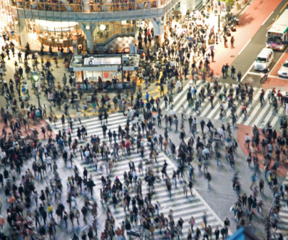
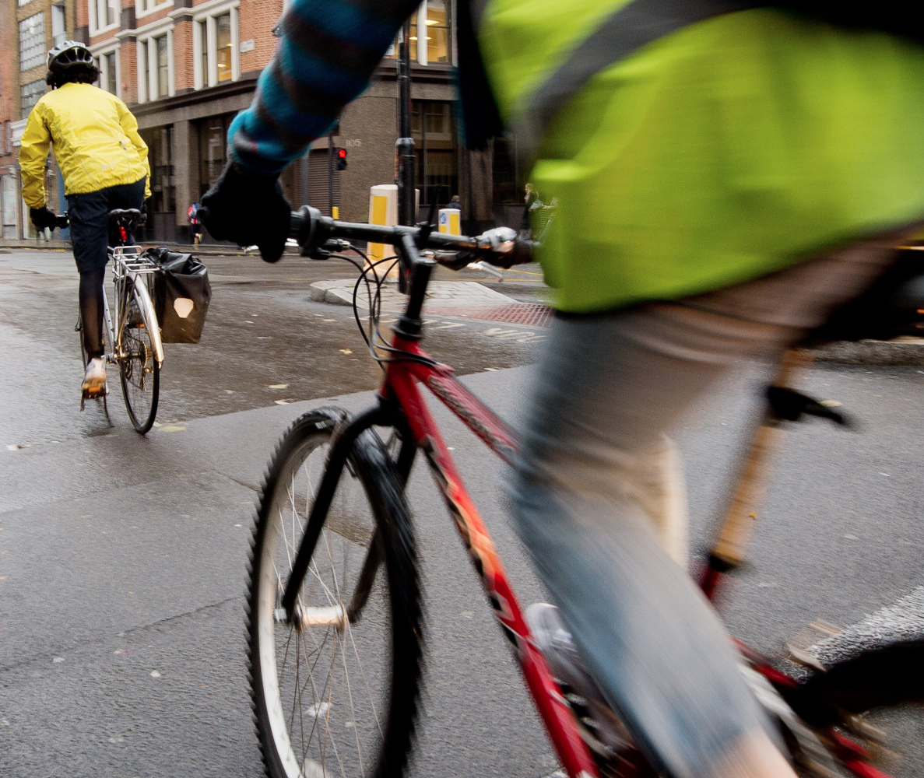
Modeling a junction
Notes:
There is also the road user to consider, roads are used by cars, buses, cyclist and pedestrians and these can each have their own rules when moving through or across a junction

Slide 9
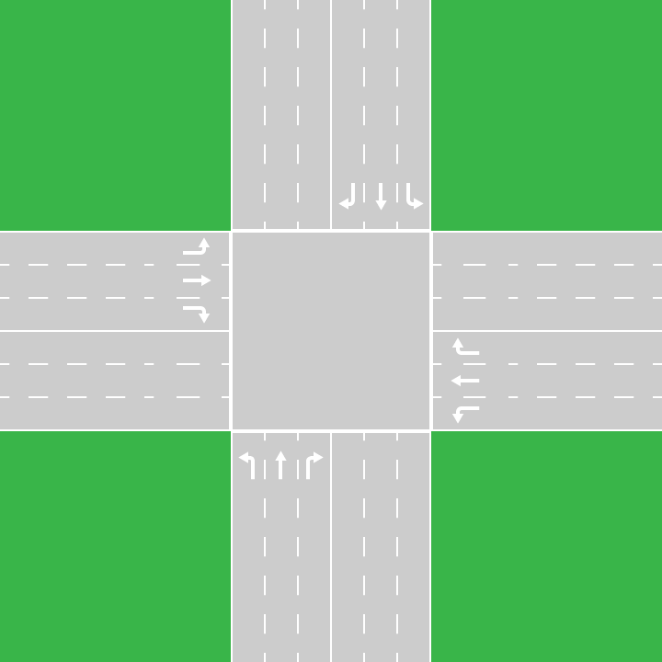
Modeling a junction
Crossroad junction
Very common junction
Very similar rules for T junctions
Often controlled by traffic lights
Manageable number of routes
Notes:
Because of our limited time frame we decided to focus on a single type of junction
We chose to use a crossroad as it is a very common junction, particularly in cities where congestion is highest
It represents the rules of other junctions such as T junctions quite well too, you can think of a t junction as a crossroad where one exit is permanently disabled
It also fits well with what we are intending to show as many crossroads are controlled by traffic lights

Slide 10
Modeling a junction
Crossroad junction
Individual lane for each exit
One car per lane in the junction at a time
It takes one time unit for a car to move through the junction
Notes:
We decided to include a separate lane for each exit, controlled by its own traffic light,
This means we know where each car is intending to go and we can deal on cars on a destination basis
We also made the rule that for each lane, a car must wait for the one ahead of it to clear the junction before it enters the junction

Slide 11
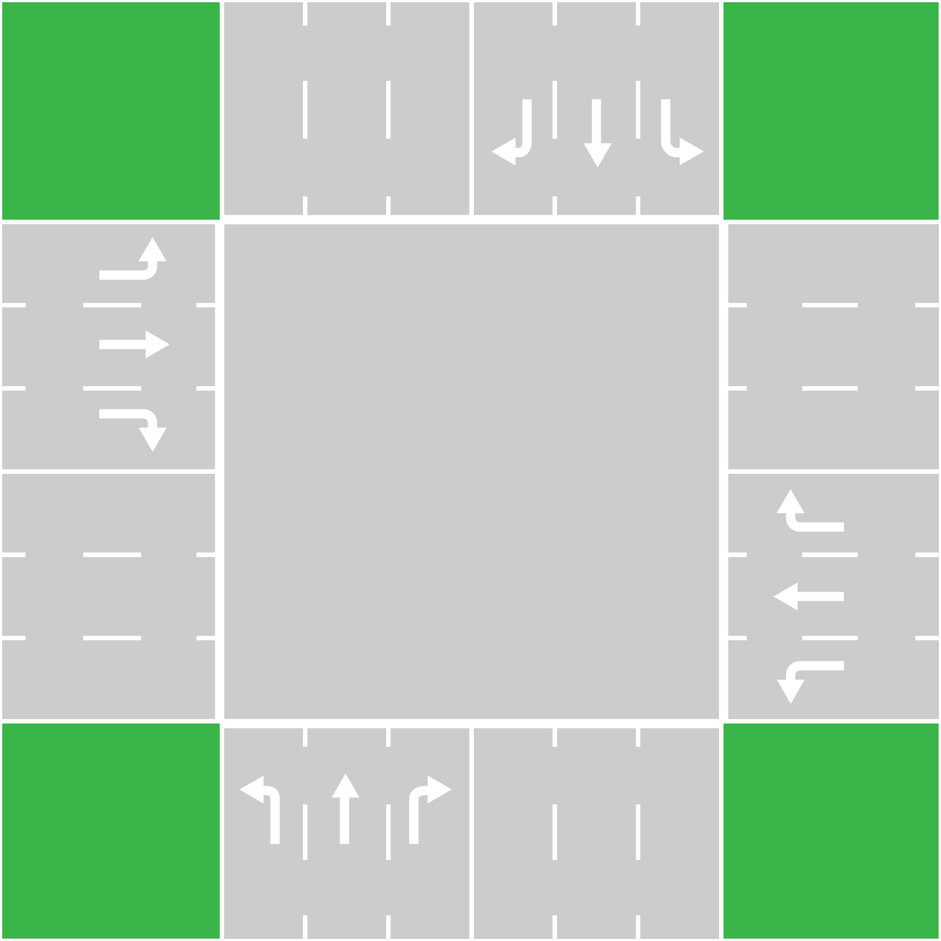
Priorities
Notes:
So we have a junction to work with, next we needed to work out where traffic is in our system in order to determine which lanes to enable.

Slide 12


Priorities
t=12
t=5
t=2
c=3
t=24
c=1
c – vehicle count
t – waiting time
Notes:
This is one of the roads coming into our junction,
You can see that each lane in our road contains a number of cars and each car has a wait time associated with it
Using these values we can come up with an priority value for each lane

Slide 13
Calculating Priorities
Method 1:
Assigns priority based on total wait time.
Method 2:
Assigns priority based on highest wait time.
Method 3:
Assigns priority based on product of wait times.
Method 4:
Number of cars in the lane.
Method 5:
Fixed timer system.
Notes:
Once we have calculated a priority value for each lane we can easily see where on our junction we need to let cars through most
However, we cannot simply set the light to green on all the most important routes because cars may collide with each other in the junction

Slide 14
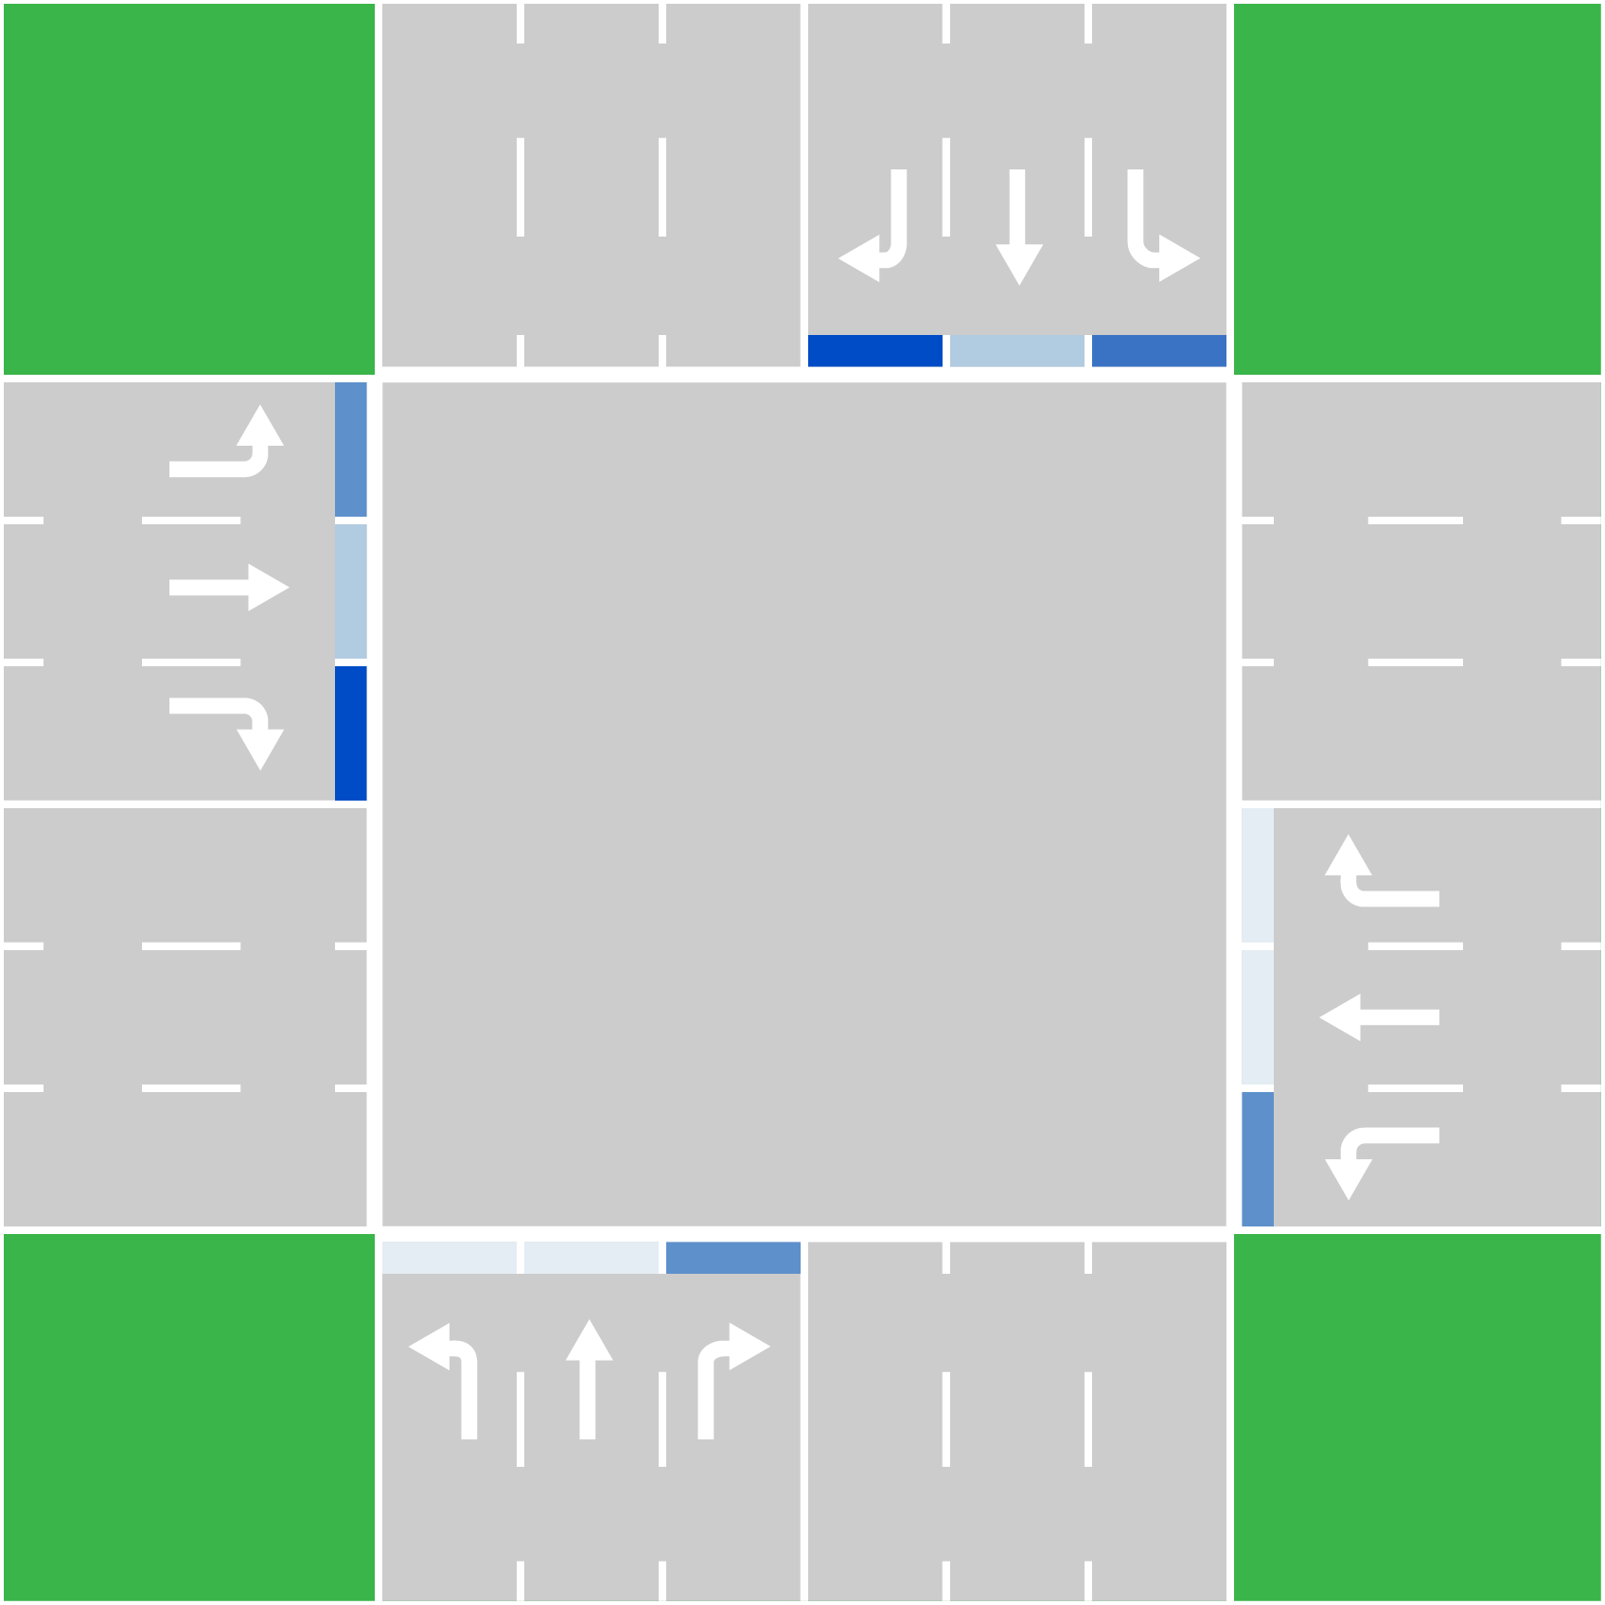
Priorities
High priority
Low priority
Notes:
Once we have calculated a priority value for each lane we can easily see where on our junction we need to let cars through most
However, we cannot simply set the light to green on all the most important routes because cars may collide with each other in the junction

Slide 15
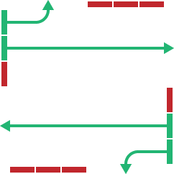
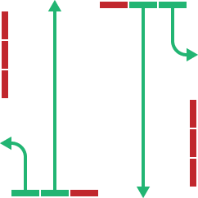
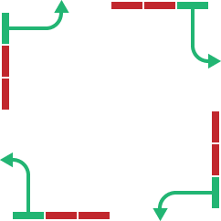
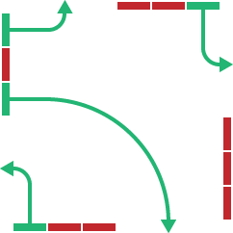
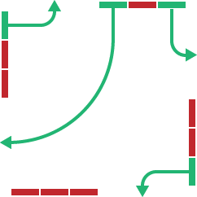
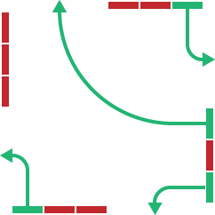
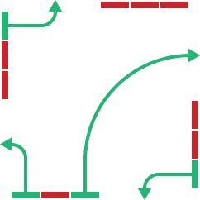
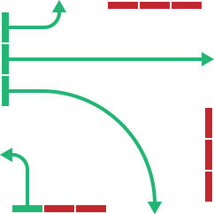
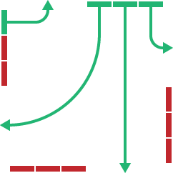
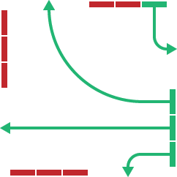
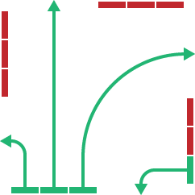
Priorities
Notes:
So, we need to look at the possible paths through the junction,
these are all the possible states that the traffic lights can be in whilst not allowing collisions.
For safety we have assumed that we do not know which exit lane a car is taking so each exit can only have one lane feeding into it at a time

Slide 16
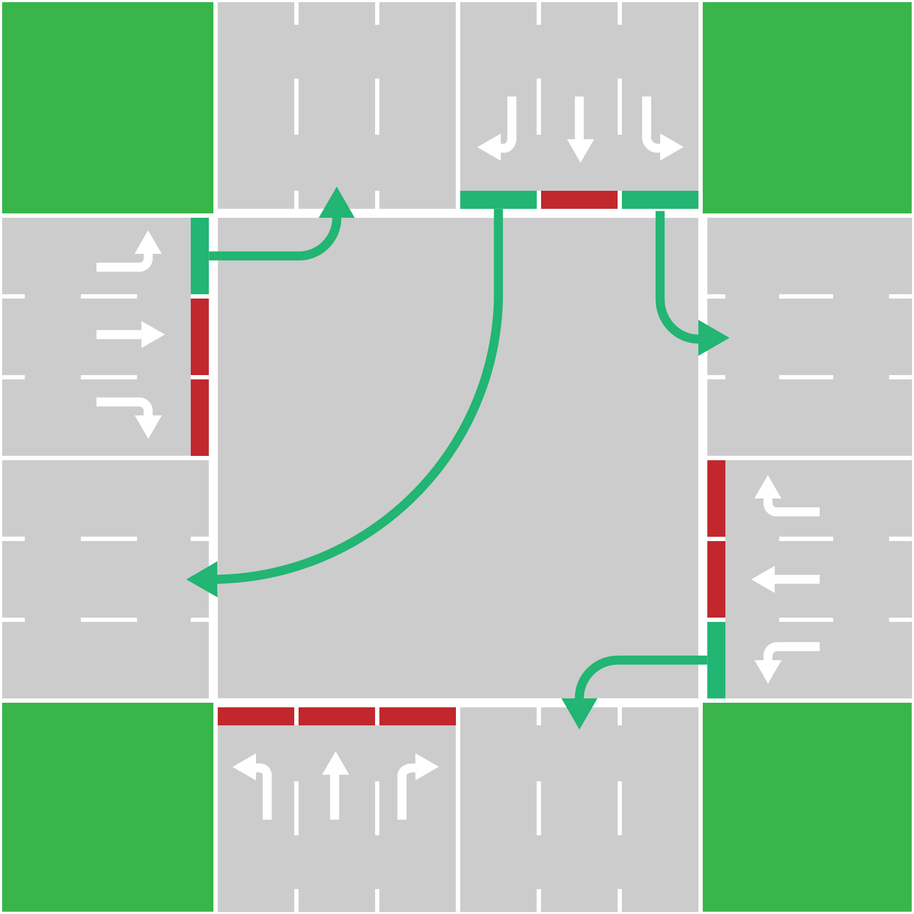
Priorities
High priority
Low priority
Notes:
Now we can begin moving vehicles through the junction.
At a certain point the priorities will change such that this route is no longer the most effective way easing congestion and we will switch to the new best route
We have also incorporated a cost of switching between routes, this is accurate to real junctions because traffic lights take time to change safely and cars take time to start moving
Without this cost the simulation would simply flip flop between routes as cars are let through

Slide 17
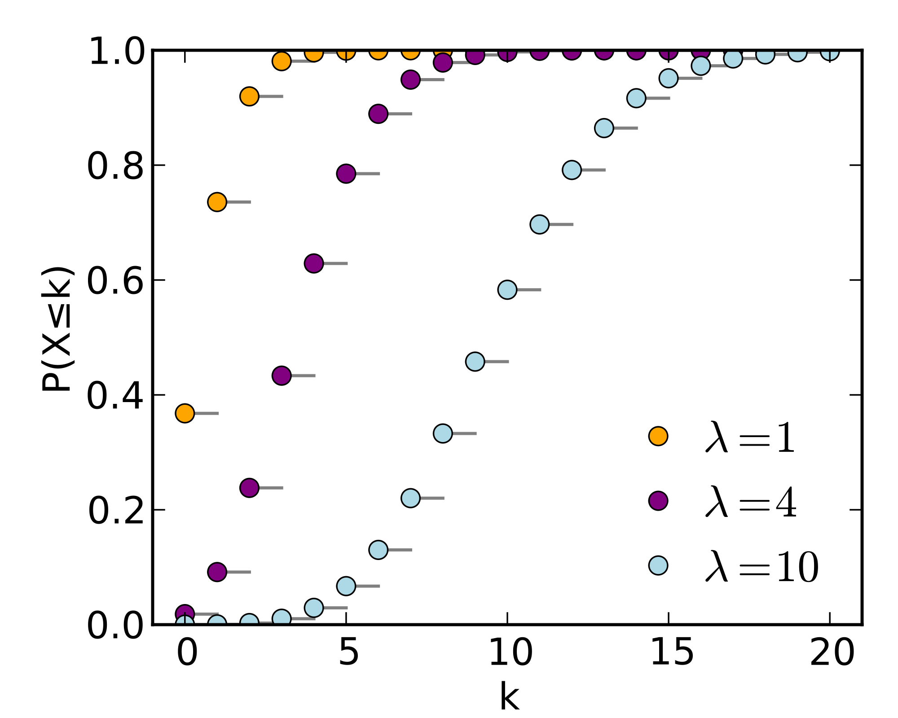
Arrivals
Notes:
In order to introduce cars into our junction in a realistic manner we have used a Poisson distribution
This allows us to have an element of randomness whilst still being able to control the overall traffic level and evaluate our model at high and low traffic levels

Slide 18
Results
Average
wait (s)
Rate

Slide 19
Results
Average
wait (s)
Comparison of wait times for rate=1

Slide 20
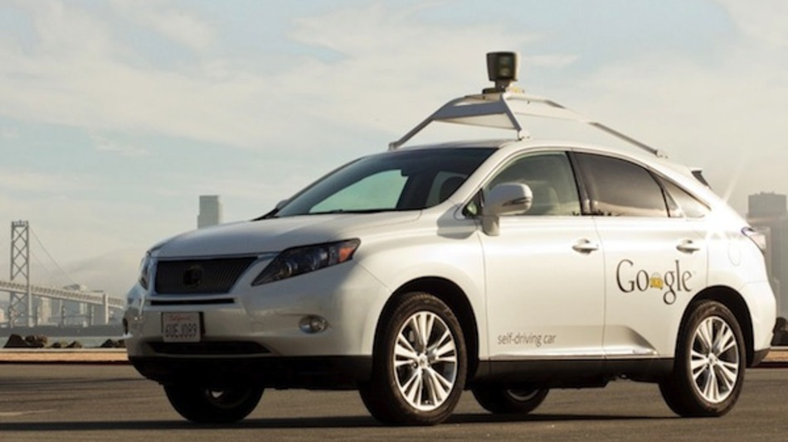

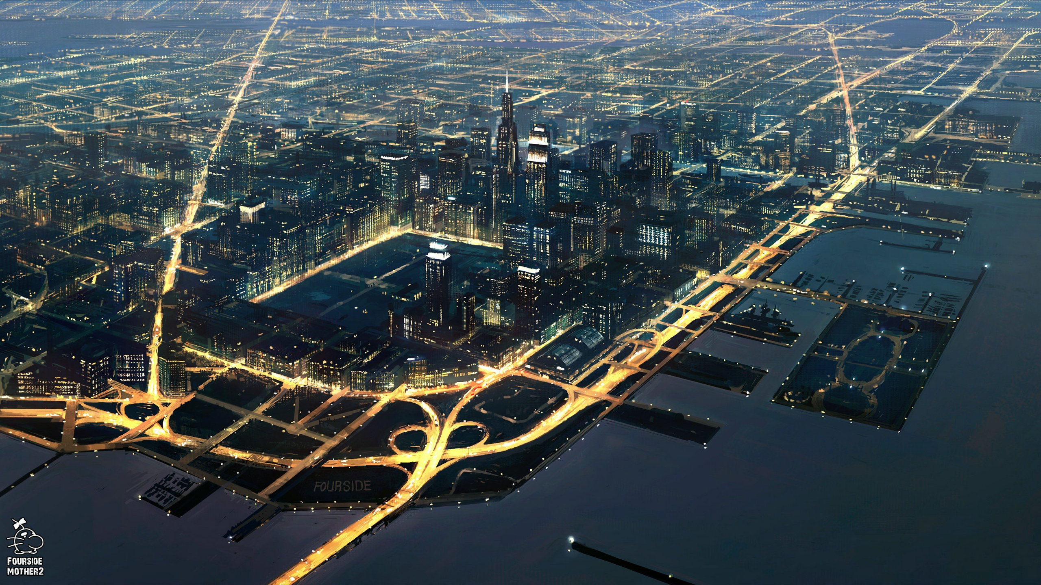
Future technologies
Notes:
Driverless Cars – Rerouting cars
Machine learning – Traffic Patterns (Rush Hour)
Whole city of networked traffic lights communicating, potential to stop traffic jams because of a whole city of communicating lights.

